Slide 1
"(There's) no such thing as a stupid question (only a stupid answer)” Subreddit Analysis
By: Guillermo Delso

Slide 2
Index
- Problem Statement
- Data Collection
- Data Cleaning & EDA
- Preprocessing & Modeling
- Evaluation and Conceptual Understanding
- Conclusion and Recommendations

Slide 3
The Problem
The saying goes like this: "(There's) no such thing as a stupid question (only a stupid answer)”.
The Boston Institute of Linguistics (BIL) wants to obtain hard evidence on the extent to which this saying is true. While the underlying goal of this saying is to support the quest for knowledge (by getting rid of the fear to look 'not-smart' for asking questions), the BIL believes that there might be some linguistic truth in this saying.
They want us to analyze whether there is much difference between the questions that obtain serious responses, and those that obtain 'bad-responses'.
The BIL has asked us to look for 'subreddits' where the answers given to potentially normal questions are bad responses, and to compare them to the questions from another subreddit where the questions receive good/normal responses.

Slide 4


The focus questions
Questions:
To what extent can we differentiate whether a post is from the r/Advice subreddit or from the r/shittysubreddit, by only looking at the post titles?
Can we improve our predictions?

Slide 5
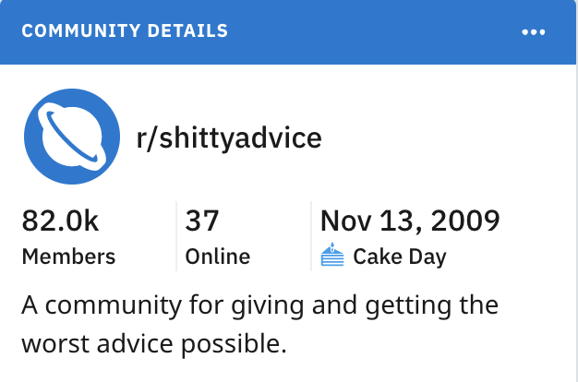


Data Collection

Slide 6
Data Collection
1st
Use the ‘request’ library, gather the data
r = requests.get('http://www.reddit.com/r/Advice.json', headers=headers)
2nd
Getting more entries (Reddit only gives us 25 posts per request)
3rd
Create a data frame with the data.
Export it into a csv
Create a ‘type’ column where the two subreddits are divided into 1 and 0 depending on which type they are.
Drop duplicates. Close to 8,000 dropped
10,000 posts

Slide 7
Data Cleaning
1st
Remove unnecessary Columns
2nd
Missing Values ?

Slide 8
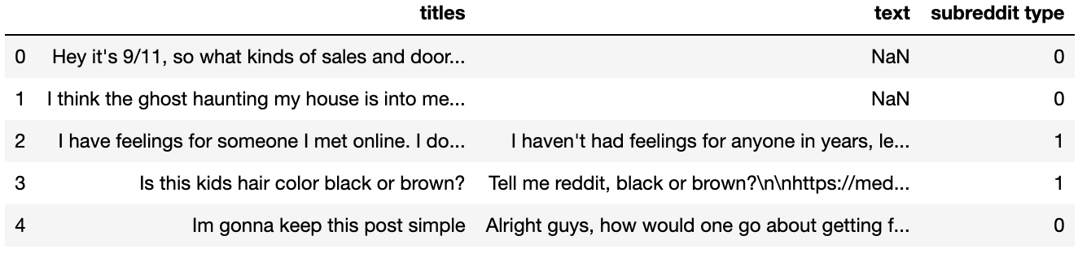
After the data cleaning…
Data Shape
(1949, 3)

Slide 9
Exploratory Data Analysis
X= data['titles']
y = data['subreddit type']

Slide 10
y_values
0 | 1
991 | 958
0 | 1
0.508466 | 0.491534

Slide 12
Most common title words in subreddit 1 (Advice)
Most common title words in subreddit 2 (shittyadvice)
friend | 78
help | 73
advice | 70
need | 69
iâ | 67
know | 49
want | 48
like | 43
just | 42
friends | 38
just | 67
want | 53
best | 53
make | 49
iâ | 48
need | 42
help | 40
way | 38
don | 37
know | 35
Not counting ‘stop_words’

Slide 13
SUBREDDIT 1: ADVICE
[('friend', 78), ('help', 73), ('advice', 70), ('need', 69), ('iâ', 67), ('know', 49), ('want', 48), ('like', 43), ('just', 42), ('friends', 38), ('job', 37), ('life', 32), ('girl', 32), ('feel', 32), ('work', 31), ('school', 31), ('don', 27), ('stop', 27), ('best', 25), ('time', 24), ('going', 24), ('make', 24), ('boyfriend', 23), ('ex', 22), ('old', 22), ('really', 22), ('college', 21), ('parents', 21), ('think', 21), ('getting', 20), ('year', 18), ('new', 17), ('got', 17), ('girlfriend', 17), ('ask', 16), ('tell', 16), ('trying', 15), ('lost', 15), ('having', 15), ('way', 14), ('people', 14), ('mom', 13), ('brother', 13), ('im', 13), ('love', 13), ('sure', 13), ('good', 13), ('crush', 12)]
SUBREDDIT 0: SHITTYADVICE
[('just', 67), ('want', 53), ('best', 53), ('make', 49), ('iâ', 48), ('need', 42), ('help', 40), ('way', 38), ('don', 37), ('know', 35), ('like', 35), ('wife', 31), ('stop', 28), ('work', 28), ('girlfriend', 28), ('got', 26), ('really', 26), ('time', 26), ('advice', 26), ('new', 25), ('day', 25), ('good', 25), ('people', 25), ('think', 24), ('going', 23), ('girl', 23),('told', 21), ('tell', 20), ('does', 20), ('sex', 19), ('reddit', 19), ('ask', 18), ('says', 18), ('life', 18), ('use', 17), ('money', 17), ('year', 16), ('dog', 16), ('car', 16), ('having', 16), ('cat', 15), ('sure', 15), ('house', 14), ('right', 14), ('getting', 14), ('guy', 14), ('buy', 14), ('friend', 14), ('friends', 14)]
Not counting ‘stop_words

Slide 14
The Models Used
Cvec
Tvec
Gridsearch Cvec
Gridsearch Tvec
Decision Trees Cvec
Decision Trees Tvec
Decision Trees Gridsearch Cvec
Decision Trees Gridsearch Tvec
BagClssifier Cvec
BagClassifier Tvec

Slide 15
Model Results
Classification Model | Train_score | Test_Score
base | 0.491188 | 0.492236
bernoulli score_cvec | 0.919540 | 0.686335
cvec_score_log | 0.966284 | 0.698758
bernoulli scoore tvec | 0.919540 | 0.686335
tvec_score_log | 0.932567 | 0.706522
cvec_best_score_gridsearch_log | 0.700383 | 0.631418
tvec_best_score_gridsearch_log | 0.689655 | 0.634483
cvec_model_estimator_gridsearch_log | 0.875862 | 0.669255
tvec_model_estimator_gridsearch_log | 0.868966 | 0.667702
Outperformed the base by close to 20% in the best-case scenario.

Slide 16
More Models…
Classification Model | Train_score | Test_Score
base | 0.491188 | 0.492236
trees_cvec_score | 0.996935 | 0.627329
trees_tvec_score | 0.996935 | 0.591615
Cvec Trees w/ hyper_params | 0.591571 | 0.576087
Tvec Trees w/ hyper_params | 0.586973 | 0.568323
Cvec Trees Gridsearch | 0.632184 | 0.604037
Tvec Trees Gridsearch | 0.617625 | 0.588509
cvec_bagclassifier_score | 0.996935 | 0.621118
tvec_bagclassifier_score | 0.996935 | 0.594720
Worse results than the log regressions.

Slide 17
Changed the data to create a better model

Slide 18
Index
Back here!
- Problem Statement
- Data Collection
- Data Cleaning & EDA
- Preprocessing & Modeling
- Evaluation and Conceptual Understanding
- Conclusion and Recommendations

Slide 19
Data Cleaning
1st
Remove unnecessary Columns
2nd
Missing Values ?
3rd
Adding the features

Slide 20
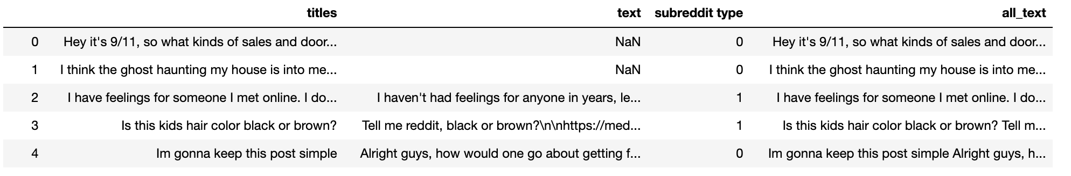
New Feature
data['all_text']= data['titles'] + ' ' + data['text'].map(str)

Slide 21
After data cleaning…
Data Shape
(1949, 4)

Slide 22
Exploratory Data Analysis
X= data[‘all_text’]
y = data['subreddit type']

Slide 23
SUBREDDIT 1: ADVICE
('just', 1275), ('like', 1208), ('iâ', 1079), ('know', 928), ('want', 793), ('really', 765), ('time', 732), ('ve', 662), ('feel', 587), ('friends', 565), ('don', 561), ('school', 521), ('said', 493), ('going', 450), ('friend', 439), ('told', 421), ('work', 412), ('help', 405), ('people', 401), ('think', 385), ('got', 379), ('things', 376), ('advice', 372), ('life', 356), ('job', 355), ('year', 348), ('need', 326), ('years', 322), ('make', 319), ('day', 319), ('lot', 308), ('way', 292), ('good', 274), ('tell', 273), ('started', 264), ('talk', 259), ('did', 259), ('girl', 254), ('say', 251), ('parents', 241), ('family', 233), ('best', 224), ('went', 223), ('house', 221), ('getting', 218), ('love', 216), ('away', 216)
SUBREDDIT 0: SHITTYADVICE
('just', 127), ('want', 109), ('help', 86), ('like', 81), ('don', 76), ('really', 76), ('need', 75), ('iâ', 74), ('know', 73), ('best', 72), ('make', 71), ('way', 59), ('advice', 55), ('think', 54), ('ve', 54), ('wife', 54), ('time', 53), ('got', 50), ('people', 49), ('work', 47), ('day', 46), ('told', 44), ('good', 40), ('going', 38), ('stop', 38), ('girl', 37), ('money', 36), ('girlfriend', 36), ('tell', 34), ('new', 33), ('reddit', 33), ('getting', 32), ('does', 32), ('cat', 31), ('guy', 31), ('life', 31), ('friend', 28), ('year', 27), ('right', 27), ('said', 27), ('school', 27), ('sex', 26), ('says', 26), ('say', 26), ('old', 25), ('having', 25), ('shit', 25), ('sure', 25), ('things', 25)
Not counting ‘stop_words

Slide 24
The Models Used
Cvec
Tvec
Gridsearch Cvec
Gridsearch Tvec
Decision Trees Cvec
Decision Trees Tvec
Decision Trees Gridsearch Cvec
Decision Trees Gridsearch Tvec
BagClssifier Cvec
BagClassifier Tvec

Slide 25
Model results
Classification Model | Train_score | Test_Score
base | 0.490847 | 0.491879
bernoulli score_cvec | 0.850575 | 0.835404
cvec_score_log | 0.987739 | 0.883540
bernoulli scoore tvec | 0.850575 | 0.835404
tvec_score_log | 0.954023 | 0.877329
cvec_best_score_gridsearch_log | 0.882759 | 0.882759
tvec_best_score_gridsearch_log | 0.881992 | 0.881992
gs_cvec_model_estimator_log | 0.976245 | 0.868012
gs_tvec_model_estimator_log | 0.923372 | 0.875776
Outperform base by almost 40% in the best-case scenario.

Slide 26
More Models…
Classification Model | Train_score | Test_Score
base | 0.490847 | 0.491879
trees_cvec_score | 1.000000 | 0.830745
trees_tvec_score | 1.000000 | 0.804348
Cvec Trees w/ hyper_params | 0.846743 | 0.833851
Tvec Trees w/ hyper_params | 0.855172 | 0.836957
Cvec Trees Gridsearch | 0.886590 | 0.843168
Tvec Trees Gridsearch | 0.895785 | 0.827640
cvec_bagclassifier_score | 1.000000 | 0.874224
tvec_bagclassifier_score | 1.000000 | 0.87111
Overall, worse results than the log regressions.

Slide 27
Model Evolution

Slide 28
Best Model
cvec_score_log (from the all_text model)
Train_score: 0.987739
Test_score : 0.883540
Test-score only

Slide 29
Conclusions
The two subreddits differ more by their texts than by their titles.
This makes sense since the titles are basically the questions regarding the advice requested. These follow a similar format in both, which leads to the similar top-10 words in both subreddits.
Nevertheless, what changes is the explanation of those requests. The text includes an explanation of the question posted. Presumably, in the subreddit ‘Advice’ titles are basic, and the explanations are more realistic. But in the subreddit ‘shittyadvice’ while the titles are also basic and similar in style to the ‘Advice’ titles, the explanation might be ‘shitty’; just like the advice it is about to receive.

Slide 30
Final Responses
Focus Questions:
To what extent can we differentiate whether a post is from the r/Advice subreddit or from the r/shittysubreddit, by only looking at the post titles?
Close to 70% accuracy
How can we improve our predictions?
By including the texts we obtain an 88% accuracy
Only using the ‘titles’:
Classification Model | Test_Score
tvec_score_log | 0.706522
Using the ‘titles’ and ‘text’:
>15%
Classification Model | Test_Score
cvec_score_log | 0.883540

